Slide 1
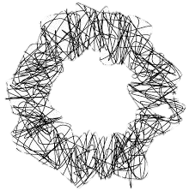
Hello my name is karen
Candidate 2008

Slide 2
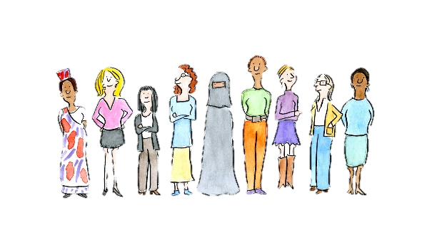









Who are they?

Slide 3
Does one size fit all when it comes to stress?
Cultural

Slide 4

Thesis / concession
Different cultures have different expectations
Different economic classes have different problems.
everyone has stress.

Slide 5
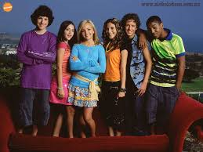
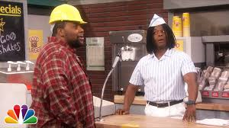

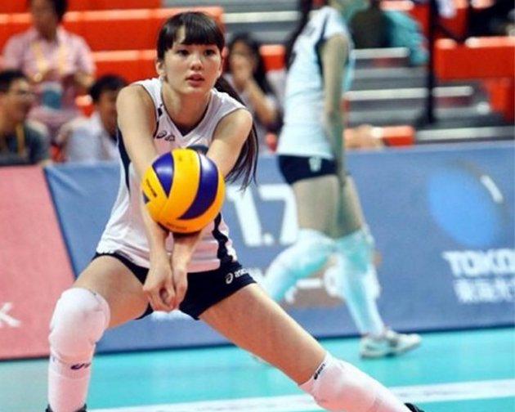
Why it’s a local problem
(Zoe 101, 2016)
(Good Burger,2016)
(Books,2016)
(volleyball,2016)

Slide 6
CULTURAL EXPECTATIONS

Slide 7
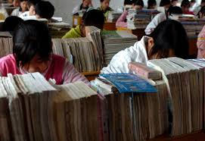
WHAT IS EXPECTED OF YOU?
“A scientific survey of 9 to 12-year-olds in eastern China found that more than 80 percent worried "a lot" about exams, two-thirds feared punishment by their teachers and almost three-quarters reported fearing physical punishment from their parents.” (Telegraph, 2010)
China Kids, 2016)

Slide 8
ECONOMIC CLASSES

Slide 9
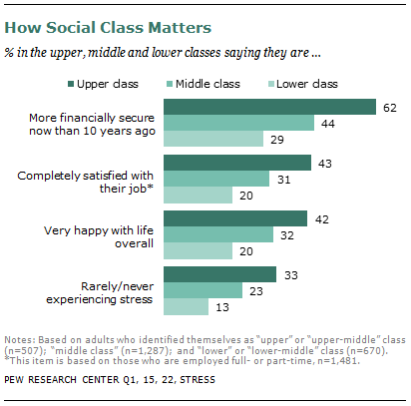
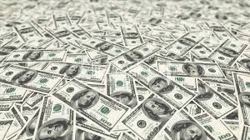
MO’ money less problems
(Money 1, 2016)
(Karen parker, 2016)

Slide 10
STRESS: EVERYONE HAS IT

Slide 11
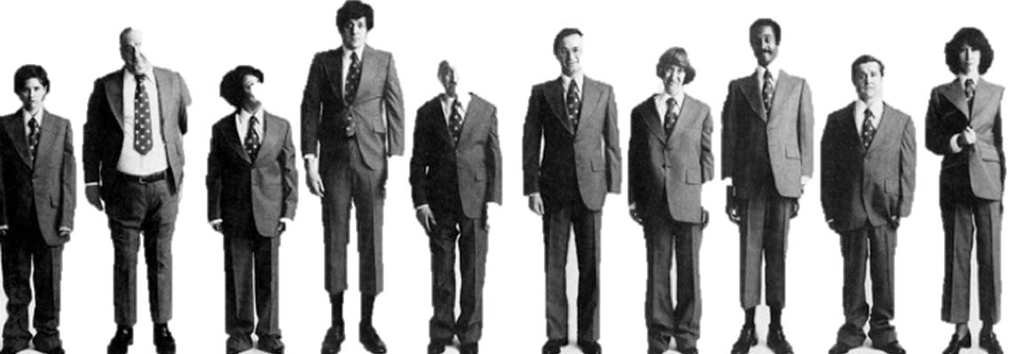
One size fits all
“Stress is simply a fact of human nature. It is a normal, unavoidable part of living. Stress is something that most people experience on a daily basis. Stress is defined as our reaction to events, environmental or internal, that are associated with substantial adaptive demands that tax or exceed our adaptive resources.” (David J. Fischer, 2013)
(A lot of men, 2016)

Slide 12
Reflection

Slide 13
References
About Dr. David J. Fischer. (2013). Retrieved April 21, 2016, from http://www.columbiapsychiatric.com/about-dr-david-j-fischer.html
About Telegraph. (2016). Editorial and commercial guidelines. Retrieved April 21, 2016, from http://www.telegraph.co.uk/topics/about-us/11570701/Editorial-and-commercial-guidelines.html
Asain Family. (2016). Retrieved April 11, 2016, from http://www.dailyherald.com/article/20140928/business/140928693/
Telegraph. (2010, January 19). Third of Chinese primary school children suffer stress, study finds. Retrieved April 21, 2016, from http://www.telegraph.co.uk/news/worldnews/asia/china/7027377/Third-of-Chinese-primary-school-children-suffer-stress-study-finds.html
Books. (2016). Retrieved April 11, 2016, from http://previews.123rf.com/images/dirkercken/dirkercken1010/dirkercken101000004/8012927-school-books-on-a-stack-educational-textbooks-wih-text-education-leads-to-knowledge-Stock-Photo.jpg
China Kids. (2016). Retrieved April 11, 2016, from http://www.chinadaily.com.cn/china/2007-05/13/content_871182.htm
Culture. (2016). Retrieved April 11, 2016, from http://www.forbes.com/sites/lizadonnelly/2012/08/17/cartoons-by-women-around-the-world-are-a-needed-perspective/#12e5a3fe8962
Good Burger. (2016). Retrieved April 11, 2016, from https://i.ytimg.com/vi/odQQ4jgGpFU/maxresdefault.jpg
Many Men. (2016). Retrieved April 11, 2016, from http://www.slideshare.net/asist_org/rolando-beyond-metadatardap2015updated
Money. (2016). Retrieved April 11, 2016, from https://www.theodysseyonline.com/money-makes-the-world-go-round
Parker, K. (2012, August 27). Yes, the Rich Are Different. Retrieved April 21, 2016, from http://www.pewsocialtrends.org/2012/08/27/yes-the-rich-are-different/
Vollyball. (2016). Retrieved April 11, 2016, from http://thestir.cafemom.com/tweens_teens/175281/girl_is_too_pretty_to
Zoe 101. (2016). Retrieved April 11, 2016, from http://zoey101.wikia.com/wiki/Season_1

